Slide 1
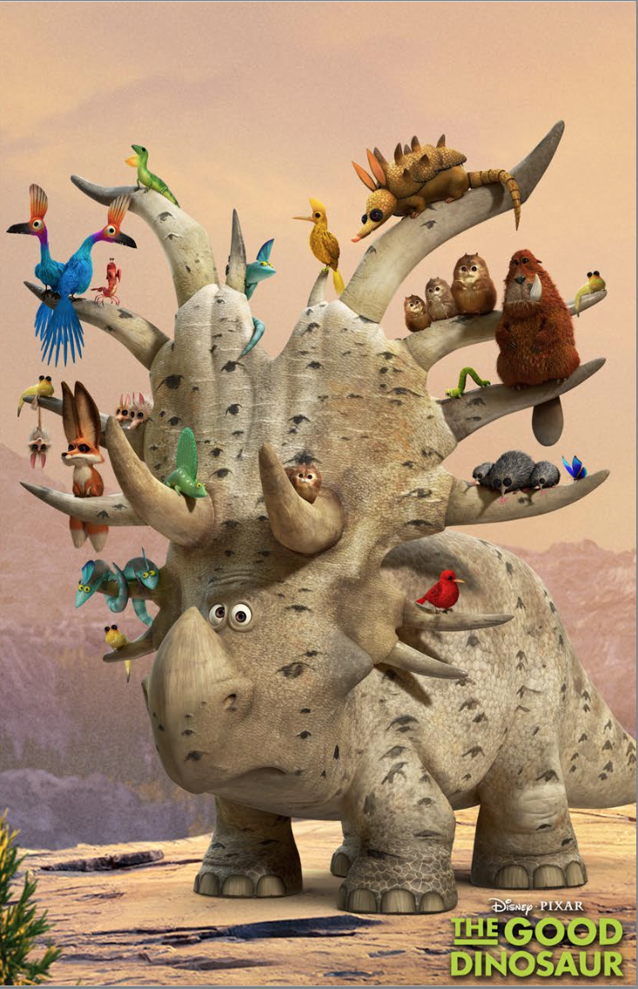
Daily Review
Reminder:
Quantitative observations are measurements. They have a numerical value and units. Qualitative observations are descriptions
Using the picture and on your whiteboard,
Write one quantitative observation
Write one qualitative observation

Slide 2
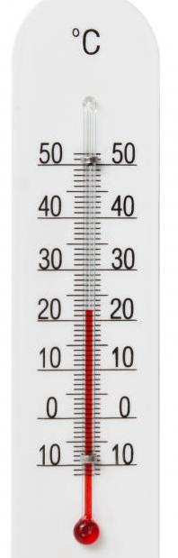
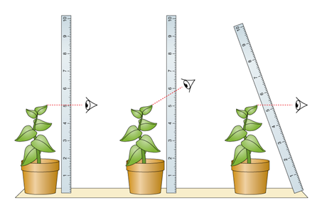
Daily Review
Reminder:
When using measuring equipment, you should be at eye-level and measure to the closest line.
What is the temperature on the thermometer? (don’t forget units)
Which part of the picture shows the correct way to measure the height of the plant? Explain your choice.
A
B
C

Slide 3
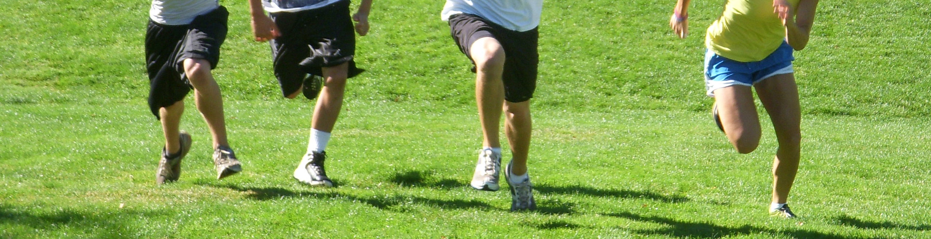
Daily Review
Reminder:
Observations are statements of fact using descriptions or measurements. Inferences are likely explanations of observations.
A student made this observation:
There are four people running across the oval
Write an inference for this observation

Slide 4
Daily Review
Reminder:
What you are trying to find an answer to is the question An aim is what you are trying to achieve in an experiment A hypothesis is a testable statement
Observation: Paper helicopters with different wing sizes fall at different rates
Write a question that can be investigated for this observation
Do paper helicopters with different wing sizes fall at different rates?
Write an aim for this investigation
To find out if paper helicopters with different wing sizes fall at different rates.
Write a hypothesis for this investigation

Slide 5
States of Matter

Slide 6
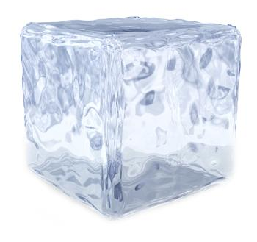

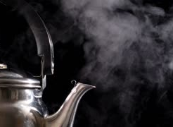
Learning Objective
CFU
What are we going to learn?
Define matter
Identify the three states of matter
Name the properties of each state of matter
Activate Prior Knowledge
Water comes in different forms.
It can be in a solid, like ice.
It can be a liquid, like tap water
It can be a gas, like steam
Think, Pair, Share: Name three solids, two liquids and one gas

Slide 7
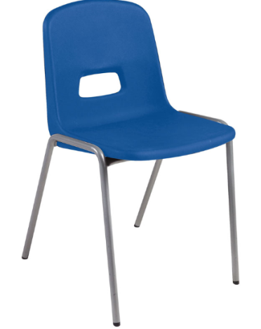
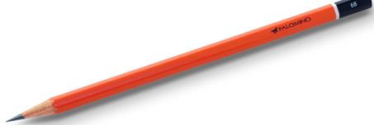


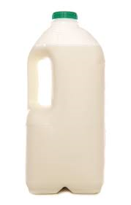
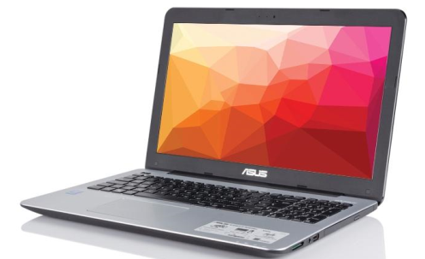
Concept Development
CFU 1
What is matter?
What is matter?
Matter is anything that has mass and volume
CFU 2
Is a table made of matter? Why?
Examples
CFU 3
Is light made of matter? Why?
Non - Examples
Vocabulary
Mass: the amount of matter in the object Volume: the amount of space the object takes up
Sound
Light

Slide 8
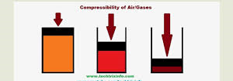
Concept Development
CFU 1
When you throw a rock into a pond, what happens to the shape of the rock?
Properties of matter
The states of matter can be described using three properties
Shape: Holds its own shape or changes to fit the container
Volume: The amount of space it takes up
Compressibility: Making the volume smaller by increasing pressure
CFU 2
Which has a larger volume, a mouse or an elephant? Explain your choice.
CFU 3
When you compress something, what happens to its volume?
Vocabulary
Mass: the amount of matter in the object Volume: the amount of space the object takes up

Slide 9
Concept Development
CFU 1
Why is a chair a solid?
Properties of Solids
Fixed shape
Fixed volume
Not compressible
Vocabulary
Volume: the amount of space the object takes up Compressible: make the volume smaller using pressure

Slide 10
Concept Development
CFU 1
Why is milk a liquid?
Properties of liquids
Variable shape
Fixed volume
Not compressible
CFU 2
How are liquids different to solids?
Vocabulary
Volume: the amount of space the object takes up Compressible: make the volume smaller using pressure

Slide 11
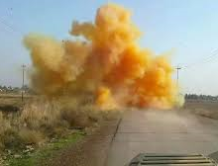
Concept Development
CFU 1
How would you describe chlorine? Why?
Properties of gases
Variable shape
Variable volume
Compressible
Chlorine Gas
Vocabulary
Volume: the amount of space the object takes up Compressible: make the volume smaller using pressure

Slide 12
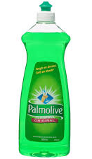
Skill Development/Guided Practice
CFU 1
Is the shape fixed or variable?
Steps for describing the state of matter
Step 1: Describe its shape (fixed or variable)
Step 2: Describe its volume (fixed or variable)
Step 3: Describe its compressibility (compressible or incompressible)
Dish soap is a liquid because it has a variable shape, a fixed volume and is incompressible.
CFU 2
Is the volume fixed or variable?
CFU 3
Is it compressible?
CFU 4
Which state of matter?
Vocabulary
Volume: the amount of space the object takes up Compressible: make the volume smaller using pressure

Slide 13
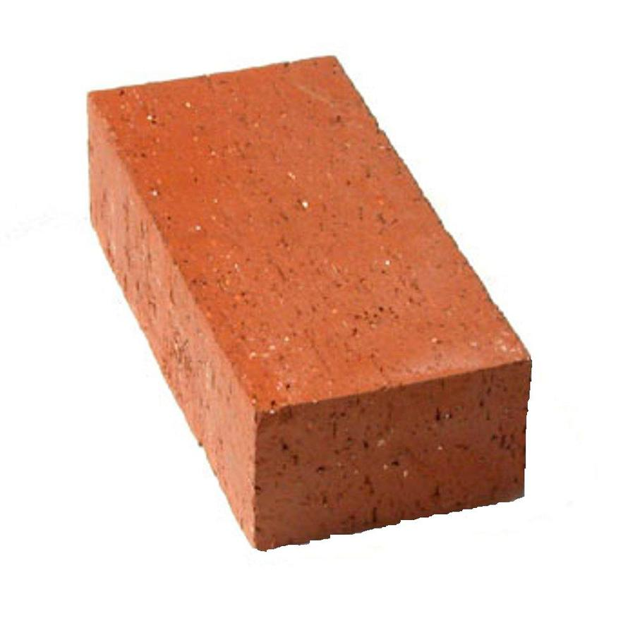
Skill Development/Guided Practice
CFU 1
Is the shape fixed or variable?
Steps for describing the state of matter
Step 1: Describe its shape (fixed or variable)
Step 2: Describe its volume (fixed or variable)
Step 3: Describe its compressibility (compressible or incompressible)
A brick is a solid because it has a fixed shape, a fixed volume and is incompressible.
CFU 2
Is the volume fixed or variable?
CFU 3
Is it compressible?
CFU 4
Which state of matter?
Vocabulary
Volume: the amount of space the object takes up Compressible: make the volume smaller using pressure

Slide 14
Skill Development/Guided Practice
CFU 1
Is the shape fixed or variable?
Steps for describing the state of matter
Step 1: Describe its shape (fixed or variable)
Step 2: Describe its volume (fixed or variable)
Step 3: Describe its compressibility (compressible or incompressible)
Steam is a gas because it has a variable shape, a variable volume and is compressible.
CFU 2
Is the volume fixed or variable?
CFU 3
Is it compressible?
CFU 4
Which state of matter?
Vocabulary
Volume: the amount of space the object takes up Compressible: make the volume smaller using pressure

Slide 15
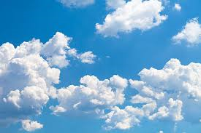
Skill Development/Guided Practice
CFU 1
Is the shape fixed or variable?
Steps for describing the state of matter
Step 1: Describe its shape (fixed or variable)
Step 2: Describe its volume (fixed or variable)
Step 3: Describe its compressibility (compressible or incompressible)
_________ are a _________ because they have a _________ shape, a _________ volume and are _______________.
CFU 2
Is the volume fixed or variable?
CFU 3
Is it compressible?
CFU 4
Which state of matter?
Vocabulary
Volume: the amount of space the object takes up Compressible: make the volume smaller using pressure

Slide 16
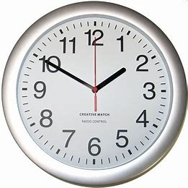
Skill Development/Guided Practice
CFU 1
Is the shape fixed or variable?
Steps for describing the state of matter
Step 1: Describe its shape (fixed or variable)
Step 2: Describe its volume (fixed or variable)
Step 3: Describe its compressibility (compressible or incompressible)
A _________ is a _________ because is has a _________ shape, a _________ volume and are _______________.
CFU 2
Is the volume fixed or variable?
CFU 3
Is it compressible?
CFU 4
Which state of matter?
Vocabulary
Volume: the amount of space the object takes up Compressible: make the volume smaller using pressure

Slide 17
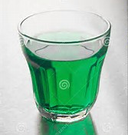
Skill Development/Guided Practice
CFU 1
Is the shape fixed or variable?
Steps for describing the state of matter
Step 1: Describe its shape (fixed or variable)
Step 2: Describe its volume (fixed or variable)
Step 3: Describe its compressibility (compressible or incompressible)
_________ is a _________ because is has a _________ shape, a _________ volume and are _______________.
CFU 2
Is the volume fixed or variable?
CFU 3
Is it compressible?
CFU 4
Which state of matter?
Vocabulary
Volume: the amount of space the object takes up Compressible: make the volume smaller using pressure

Slide 18
Relevance
The state of matter will determine how a substance will behave
The state of matter might determine how we use or store a substance.

Slide 19
Skill Closure
Reminder
Steps for describing the state of matter Step 1: Think about its shape Step 2: Think about its volume Step 3: Thing about its compressibility
Name a liquid and describe its properties.
Skill Closure
Name a solid and describe its properties.
Skill Closure
What is one property of gases that neither solid or liquids have?

Slide 20
Independent Practice
In your books or on your device
Write a one sentence description of the properties of solids, liquids and gases (shape/volume/compressibility)
Draw a table with three columns. Label the columns solids, liquids and gases. Put the substances listed below in the correct column of your table.
Olive oil, glass, Freddo frog, table, steam, paper, honey, apple, orange juice, computer, $1 coin, oxygen, cordial, carbon dioxide, milk, water
3. Add two more substances to each of your columns.

